Slide 1
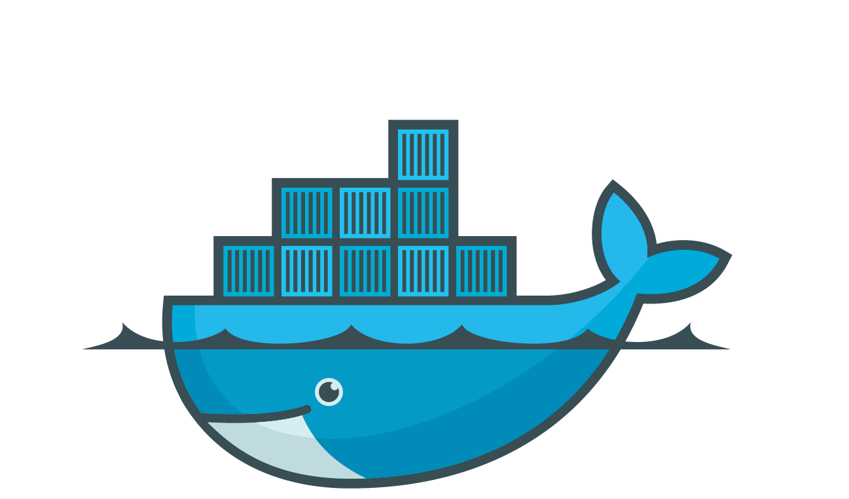
Module 10: Docker Compose
Docker Workshop
© Copyright SELA Software & Education Labs Ltd. | 14-18 Baruch Hirsch St Bnei Brak, 51202 Israel | www.selagroup.com | Leon Jalfon - Blog: http://blogs.microsoft.co.il/leonj

Slide 2
What is docker compose?
Features
Installation
YML File
Commands
Lab 10: Simple Docker Compose
Dive into the YML File
Lab 11: Docker Compose
© Copyright SELA Software & Education Labs Ltd. | 14-18 Baruch Hirsch St Bnei Brak, 51202 Israel | www.selagroup.com | Leon Jalfon - Blog: http://blogs.microsoft.co.il/leonj

Slide 3
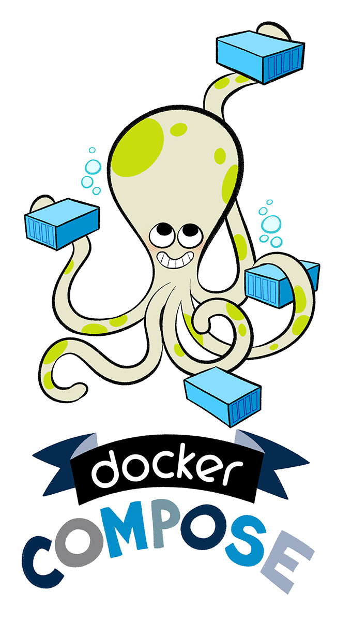

What is docker compose?
Docker Compose is a tool for defining and running complex applications with Docker.
Define a multi-container application in a single file
Spin your application up in a single command
© Copyright SELA Software & Education Labs Ltd. | 14-18 Baruch Hirsch St Bnei Brak, 51202 Israel | www.selagroup.com | Leon Jalfon - Blog: http://blogs.microsoft.co.il/leonj

Slide 4
Features
Multiple isolated environments on a single host
Preserve volume data when containers are created
Only recreate containers that have changed
Variables and moving a composition between environments
Multiple compose files
© Copyright SELA Software & Education Labs Ltd. | 14-18 Baruch Hirsch St Bnei Brak, 51202 Israel | www.selagroup.com | Leon Jalfon - Blog: http://blogs.microsoft.co.il/leonj

Slide 5
Installation
Windows / Mac - Docker Compose is included ☺
Linux:
sudo curl -L https://github.com/docker/compose/releases/download/1.21.2/docker-compose-$(uname -s)-$(uname -m) -o /usr/local/bin/docker-compose
sudo chmod +x /usr/local/bin/docker-compose
Test the installation
docker-compose --version
© Copyright SELA Software & Education Labs Ltd. | 14-18 Baruch Hirsch St Bnei Brak, 51202 Israel | www.selagroup.com | Leon Jalfon - Blog: http://blogs.microsoft.co.il/leonj

Slide 6
Before Docker Compose
$ docker run -d -it --name redis redis
$ docker run -d -it --name postgres linhmtran168/postgres
$ docker run -d -it --name web \ -v ~/Dev/gitlab.com/linhmtran168/test-project:/var/www/html \ --link postgres:db --link redis:redis linhmtran168/php-web
$ docker run -d -it -p 80:80 --name nginx \ --link web:web --volumes-from web linhmtran168/php-nginx
$ docker run -d -it --name node --link web:web \ --volumes-from web linhmtran168/gulp-bower
© Copyright SELA Software & Education Labs Ltd. | 14-18 Baruch Hirsch St Bnei Brak, 51202 Israel | www.selagroup.com | Leon Jalfon - Blog: http://blogs.microsoft.co.il/leonj

Slide 7
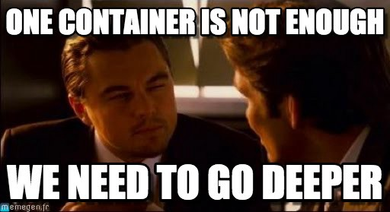
After Docker Compose
web:
build: .
links:
- redis:redis
- postgres:db
volumes:
- .:/var/www/html
nginx:
build: ../docker-php-nginx
ports:
- "80:80"
links:
- web:web
volumes_from:
- web
© Copyright SELA Software & Education Labs Ltd. | 14-18 Baruch Hirsch St Bnei Brak, 51202 Israel | www.selagroup.com | Leon Jalfon - Blog: http://blogs.microsoft.co.il/leonj

Slide 8
YML File
Version
Services
Build
Image
Environment
Ports
Volumes
Volumes
Networks
© Copyright SELA Software & Education Labs Ltd. | 14-18 Baruch Hirsch St Bnei Brak, 51202 Israel | www.selagroup.com | Leon Jalfon - Blog: http://blogs.microsoft.co.il/leonj

Slide 9
Simple YML File
version: '3'
services:
jenkins:
image: jenkins/jenkins:lts
ports:
- “8080:8080”
- “50000:50000”
artifactory:
image: docker.bintray.io/jfrog/artifactory-oss:latest
ports:
- 8081:8081
© Copyright SELA Software & Education Labs Ltd. | 14-18 Baruch Hirsch St Bnei Brak, 51202 Israel | www.selagroup.com | Leon Jalfon - Blog: http://blogs.microsoft.co.il/leonj

Slide 10
Commands
Create and start all the containers listed in the “docker-compose.yml”
$ docker-compose up -d
List all the containers belong to the compose environment instance:
$ docker-compose ps
Sets the number of containers:
$ docker-compose scale web=3
© Copyright SELA Software & Education Labs Ltd. | 14-18 Baruch Hirsch St Bnei Brak, 51202 Israel | www.selagroup.com | Leon Jalfon - Blog: http://blogs.microsoft.co.il/leonj

Slide 11
Commands
build Build or rebuild services
help Get help on a command
kill Kill containers
logs View output from containers
port Print the public port for a port binding
ps List containers
pull Pulls service images
rm Remove stopped containers
run Run a one-off command
scale Set number of containers for a service
start Start services
stop Stop services
restart Restart services
up Create and start containers
© Copyright SELA Software & Education Labs Ltd. | 14-18 Baruch Hirsch St Bnei Brak, 51202 Israel | www.selagroup.com | Leon Jalfon - Blog: http://blogs.microsoft.co.il/leonj

Slide 12
Docker Compose
© Copyright SELA Software & Education Labs Ltd. | 14-18 Baruch Hirsch St Bnei Brak, 51202 Israel | www.selagroup.com | DevOps Course | Leon Jalfon – leonj@sela.co.il

Slide 13
Lab 10: Simple Docker Compose
https://gitlab.com/docker-workshop/Lab-11
© Copyright SELA Software & Education Labs Ltd. | 14-18 Baruch Hirsch St Bnei Brak, 51202 Israel | www.selagroup.com | Leon Jalfon - Blog: http://blogs.microsoft.co.il/leonj

Slide 14
Dive into the YML File
version: '3'
services:
jenkins:
image: jenkins/jenkins:lts
ports:
- “8080:8080”
- “50000:50000”
myapp:
build: ./dir
Image / Build
image: jenkins/jenkins:lts
build: ./dir
© Copyright SELA Software & Education Labs Ltd. | 14-18 Baruch Hirsch St Bnei Brak, 51202 Israel | www.selagroup.com | Leon Jalfon - Blog: http://blogs.microsoft.co.il/leonj

Slide 15
Dive into the YML File
version: '3'
services:
web:
build: .
depends_on:
- db
- redis
Depends_on
web:
build: .
depends_on:
- db
- redis
© Copyright SELA Software & Education Labs Ltd. | 14-18 Baruch Hirsch St Bnei Brak, 51202 Israel | www.selagroup.com | Leon Jalfon - Blog: http://blogs.microsoft.co.il/leonj

Slide 16
Dive into the YML File
version: '3'
services:
jenkins:
image: jenkins/jenkins:lts
ports:
- “8080:8080”
- “50000:50000”
restart: alwayes
Restart
restart: "no"
restart: always
restart: on-failure
restart: unless-stopped
© Copyright SELA Software & Education Labs Ltd. | 14-18 Baruch Hirsch St Bnei Brak, 51202 Israel | www.selagroup.com | Leon Jalfon - Blog: http://blogs.microsoft.co.il/leonj

Slide 17
Dive into the YML File
version: '3'
services:
jenkins:
image: jenkins/jenkins:lts
ports:
- “8080:8080”
- “50000:50000”
restart: always
environment:
MYSQL_USER: wordpress
env_file: .env
Environment
MYSQL_USER: wordpress
MYSQL_PASSWORD: wordpress
Environment File
env_file: .env
© Copyright SELA Software & Education Labs Ltd. | 14-18 Baruch Hirsch St Bnei Brak, 51202 Israel | www.selagroup.com | Leon Jalfon - Blog: http://blogs.microsoft.co.il/leonj

Slide 18
Dive into the YML File
version: '3'
services:
jenkins:
image: jenkins/jenkins:lts
ports:
- “8080:8080”
- “50000:50000”
restart: always
environment:
MYSQL_USER: wordpress
networks:
- sela
networks:
sela:
other:
Networks
web:
networks:
- sela
networks:
sela:
other:
© Copyright SELA Software & Education Labs Ltd. | 14-18 Baruch Hirsch St Bnei Brak, 51202 Israel | www.selagroup.com | Leon Jalfon - Blog: http://blogs.microsoft.co.il/leonj

Slide 19
Dive into the YML File
version: '3'
services:
jenkins:
image: jenkins/jenkins:lts
ports:
- “8080:8080”
- “50000:50000”
restart: always
environment:
MYSQL_USER: wordpress
networks:
- sela
volumes:
- dbdata:/var/lib/postgresql/data
networks:
sela:
other:
Volumes:
dbdata:
Volumes
volumes:
- "dbdata:/var/lib/postgresql/data"
volumes :
dbdata:
© Copyright SELA Software & Education Labs Ltd. | 14-18 Baruch Hirsch St Bnei Brak, 51202 Israel | www.selagroup.com | Leon Jalfon - Blog: http://blogs.microsoft.co.il/leonj

Slide 20
Docker Compose
© Copyright SELA Software & Education Labs Ltd. | 14-18 Baruch Hirsch St Bnei Brak, 51202 Israel | www.selagroup.com | DevOps Course | Leon Jalfon – leonj@sela.co.il

Slide 21
Lab 11: Docker Compose
https://gitlab.com/docker-workshop/Lab-12
© Copyright SELA Software & Education Labs Ltd. | 14-18 Baruch Hirsch St Bnei Brak, 51202 Israel | www.selagroup.com | Leon Jalfon - Blog: http://blogs.microsoft.co.il/leonj

Slide 22
© Copyright SELA Software & Education Labs Ltd. | 14-18 Baruch Hirsch St Bnei Brak, 51202 Israel | www.selagroup.com | Leon Jalfon - Blog: http://blogs.microsoft.co.il/leonj

